Slide 1

Halotechnics High Throughput Chemistry and Materials Characterization
December 2015
Justin Raade, PhD
CEO and Founder
jraade@halotechnics.com
(510) 693-7116

Slide 2









High throughput chemistry lab
High temperature materials are the key to abundant clean energy
Powerful product development lab built with $5 million in investment and federal R&D grants from NSF, DOE, and ARPA-E
Capable of developing molten salt, glass, and oxide products for a broad range of applications
Synthesize and screen 200 materials/day
Selected Partners and Customers
Seeking strategic acquirer interested in rapid product development of thermal materials

Slide 3
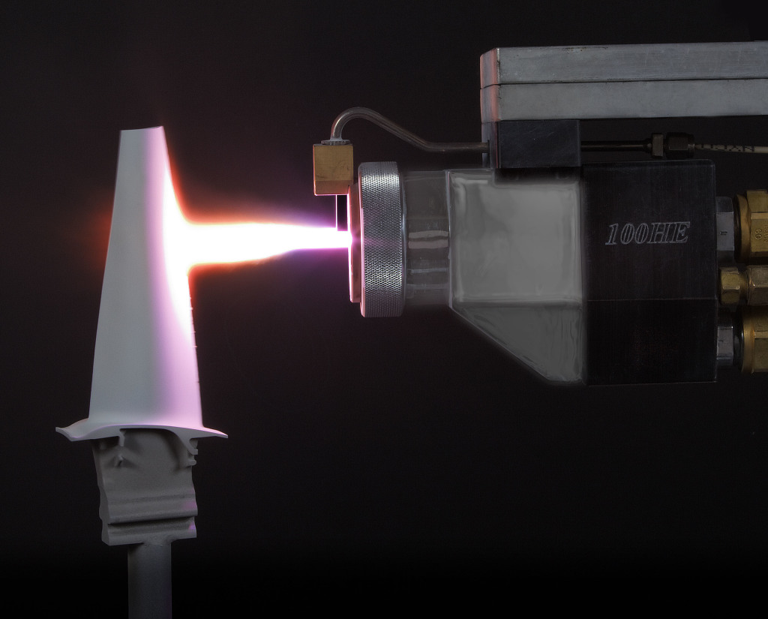
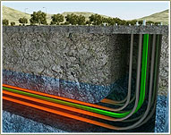
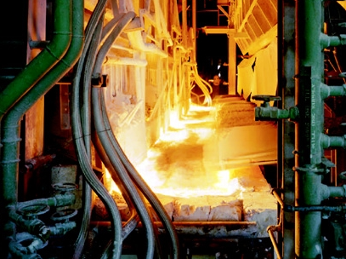

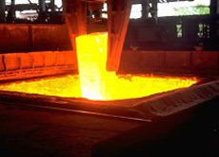
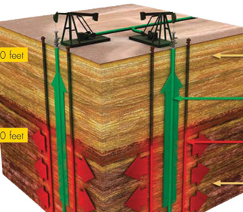
Halotechnics Thermal Materials Applications
Heavy oil upgrading
Thermal barrier coatings
Glass manufacturing
Energy storage for peak demand
Steel manufacturing
In-situ oil shale conversion
Aluminum
smelting
Power Generation
Waste Heat Recovery
Energy
Halotechnics Thermal Materials Platform

Slide 4
Laboratory Capabilities Summary
Laboratory Overview
Halotechnics has developed a complete suite of capabilities for thermal materials synthesis and characterization:
Proprietary material design software and database
High-throughput screening
Melting point, heat capacity, heat of fusion
Thermal stability
Viscosity
Density
Corrosion and materials compatibility

Slide 5
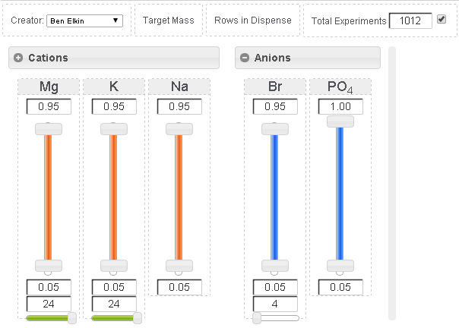
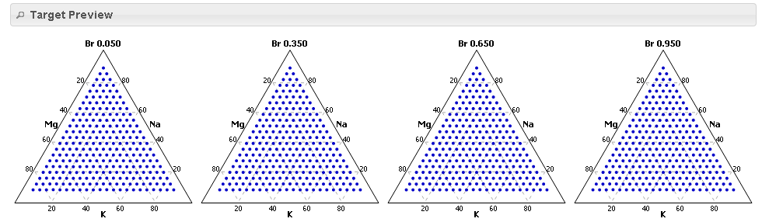
1. Material design software and database
Halotechnics custom-built software allows the designer to vary multiple salt ions and view the projected phase space in real time.
Once a design is settled, the candidates are dispensed, synthesized, and screened for melting point.
Searchable database of 23,000 mixtures including nitrates, chlorides, carbonates, sulfates, oxides
PO₄ 0.950
PO₄ 0.650
PO₄ 0.350
PO₄ 0.050

Slide 6
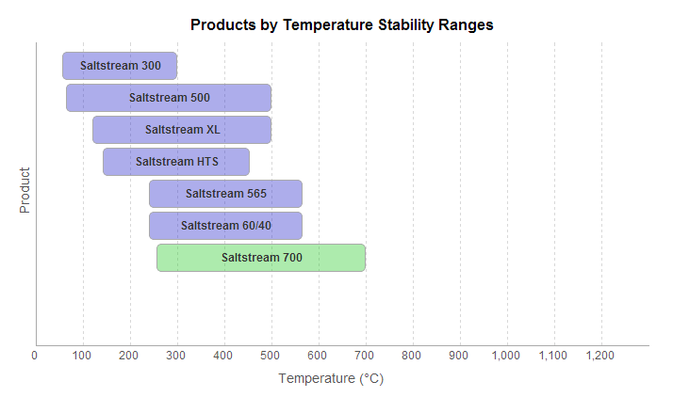

1. Material design software and database
Halotechnics products were developed by screening over 23,000 unique mixtures
Properties in searchable database: composition, melting point, thermal stability
Saltstream and Haloglass
Enabling a new class of applications in extreme heat
www.halotechnics.com/products

Slide 7
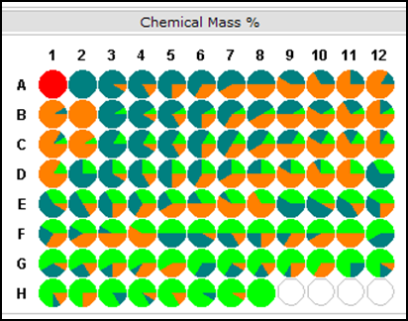
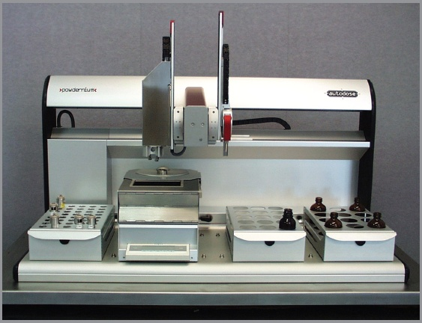
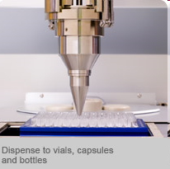
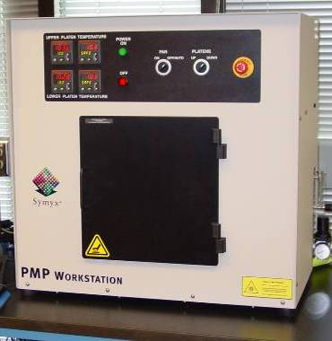
2. High-Throughput Screening
Workflow:
Halotechnics leverages its high-throughput chemistry screening capabilities
to survey thousands of multi-component materials across broad phase spaces.
Library Design
Powder Dispense
Parallel Melting Point Analysis

Slide 8
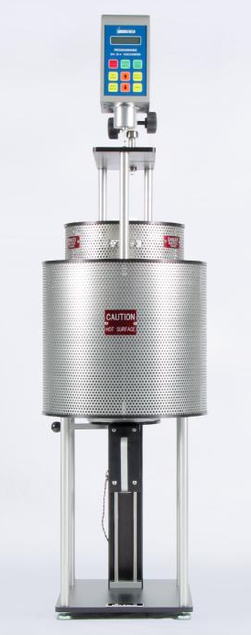
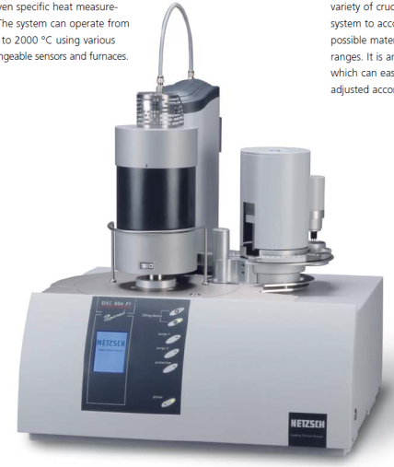
2. High-Throughput Screening
High throughput workflow capable of screening 200 mixtures/day
3000
Melting
point
PMP
200
Heat
capacity
20
DSC
Viscosity
Viscometer
5
Corrosion
Optimized molten salt

Slide 9
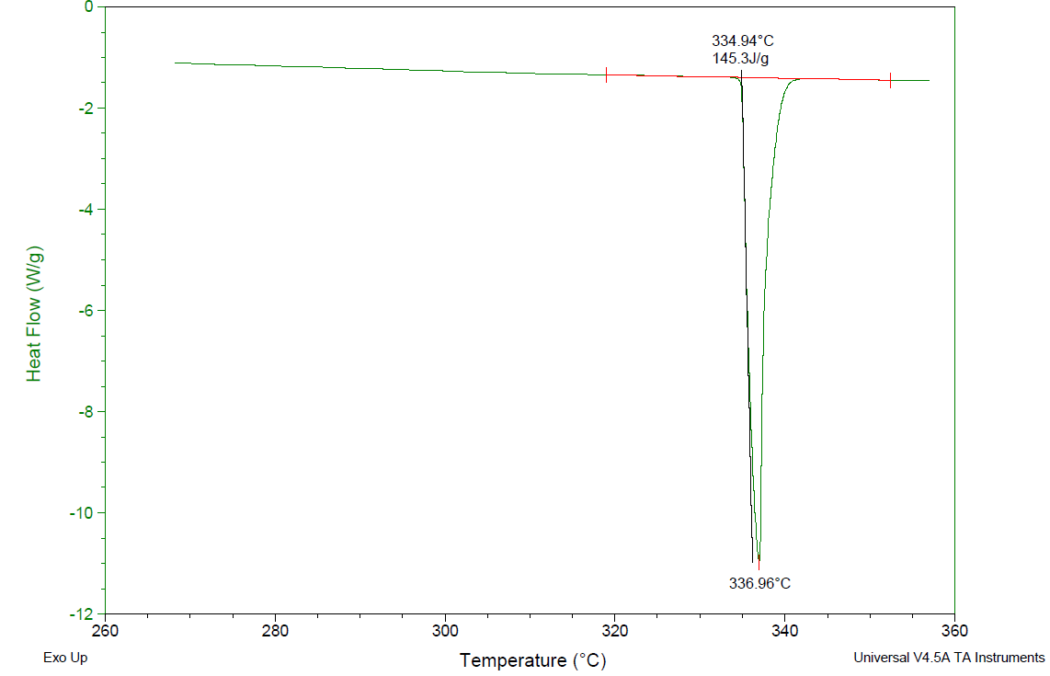
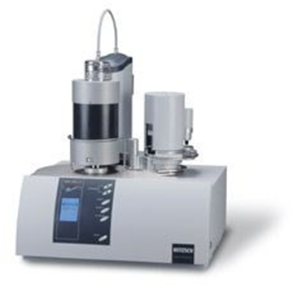
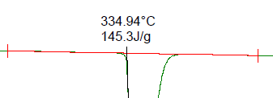
3. Melting point, heat capacity, heat of fusion
Differential Scanning Calorimeter (DSC): Netzsch 404 F1 Pegasus, 20-position autosampler
Measure thermal properties up to 1500 °C
Melting point
Heat of fusion
Heat capacity
Glass transition and crystallization
DSC graph of potassium nitrate

Slide 10
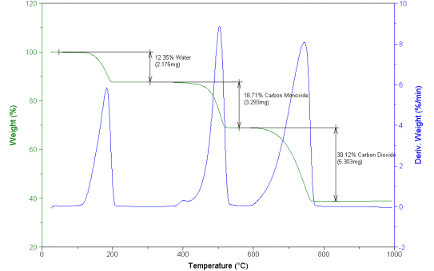
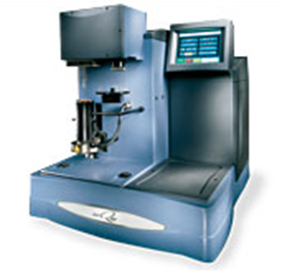
4. Thermal Stability
Thermogravimetric Analysis (TGA): TA Instruments Q500
Measure dehydration and decomposition reactions at temperatures up to 1000 °C
Atmospheric gas control, air vs inert
TGA thermal stability behavior of calcium oxalate reference material

Slide 11
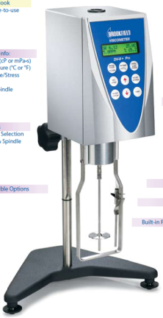
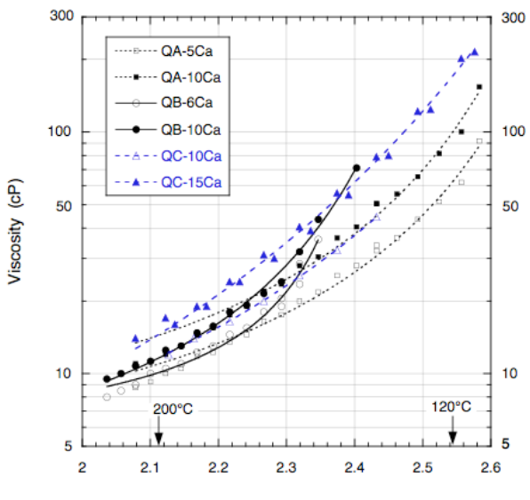
5. Viscosity
Measure viscosity vs. temperature, a critical parameter for systems design/engineering.
Orton molten glass viscometer capable of operation up to 1600 °C
Modified Brookfield viscometer capable of measuring molten salt viscosity from room temperature up to 565 °C.
Viscosity data for quaternary salt mixtures (Bradshaw and Siegel, 2009)

Slide 12
6. Density
Measure density vs. temperature with Halotechnics’ custom-built Archimedean furnace density measurement system:
Stainless steel sinker hung beneath analytical balance
Sinker suspended in molten salt inside temperature-controlled crucible furnace
Buoyancy force offsets weight
Data acquisition system computes density as a function of temperature
Balance
Crucible
Sinker
Molten salt
Heating element

Slide 13
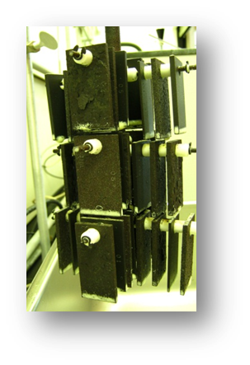
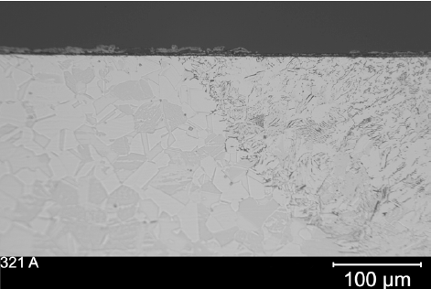
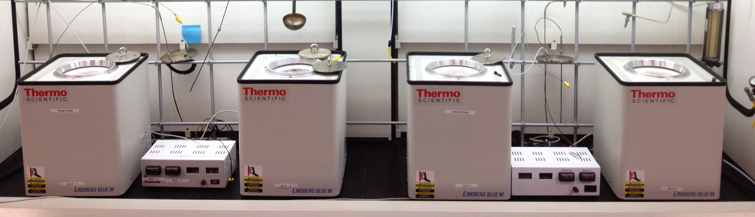
7. Corrosion and Materials Compatibility
Corrosion Testing Protocol
Crucible furnaces with stainless steel, carbon steel, and nickel-based coupons immersed in molten salt for 3000-hour corrosion test at temperatures up to 700 °C:
Sample coupons at regular
500-hour intervals
Post test analysis:
Cross section analysis
Weight loss
Microscopy imaging
Ion analysis of salt

Slide 14
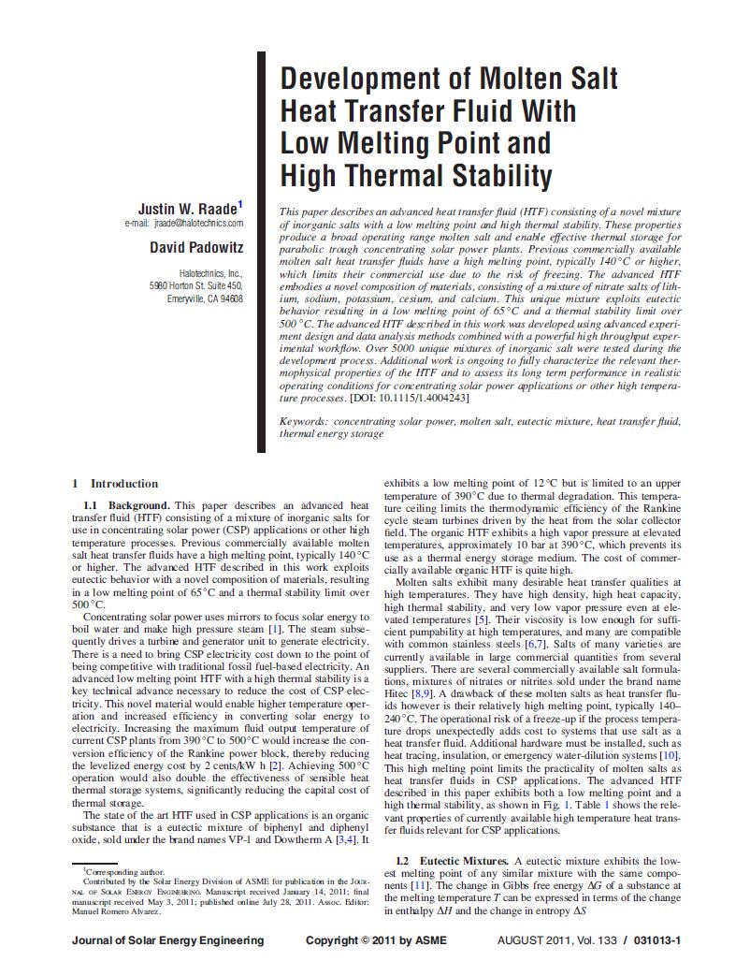
Salt development case study #1
Screened over 5,000 unique compositions in search of molten salt heat transfer fluid
Experiments surveyed a broad phase space of nitrate, nitrite, chloride, carbonate, and sulfate salts
J. W. Raade and D. Padowitz, Journal of Solar Energy Engineering, Vol. 133, Issue 3, 2011.
Phase space with eutectic mixture of LiNO3-NaNO3-KNO3-CsNO3-Ca(NO3)2

Slide 15
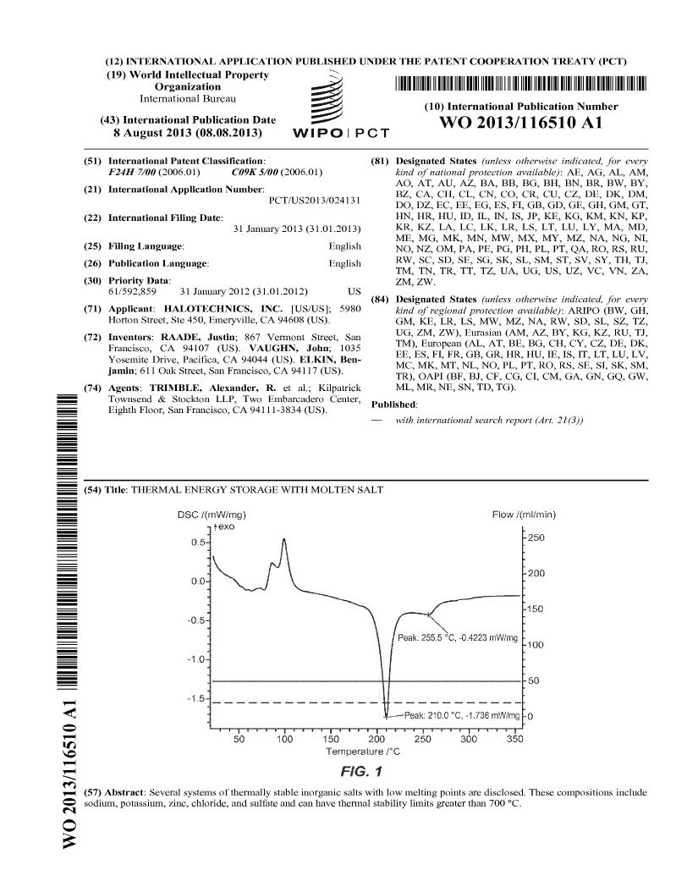
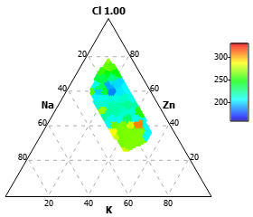
Salt development case study #2
SaltstreamTM 700: High temperature heat transfer fluid consisting of ZnCl2-NaCl-KCl and related mixtures
PCT patent application filed, active status. IP available for acquisition.
J. W. Raade, J. Vaughn, B. Elkin, “Thermal energy storage with molten salt,” U.S. patent application 61/592,859, 2012.
Phase space with mixtures of ZnCl2-NaCl-KCl

Slide 16
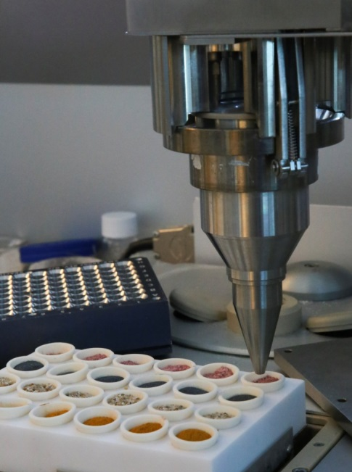
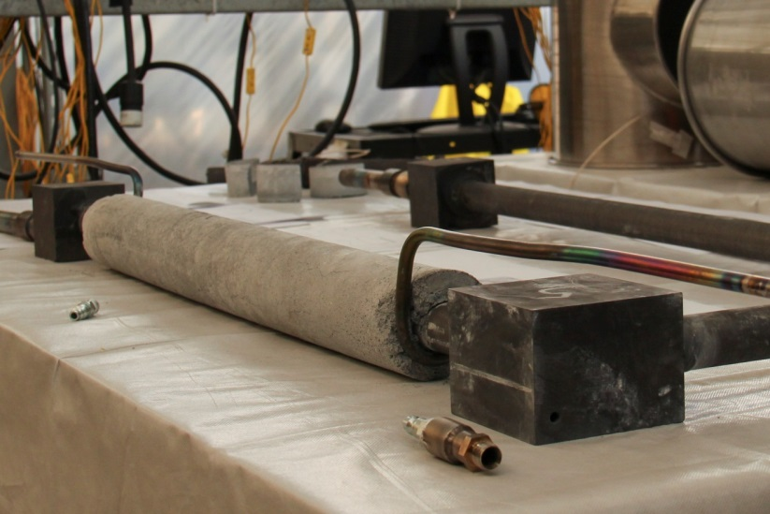
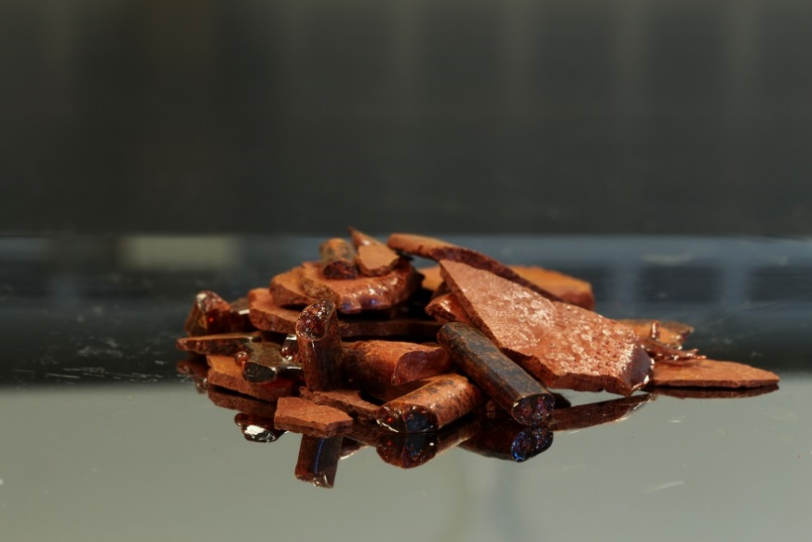
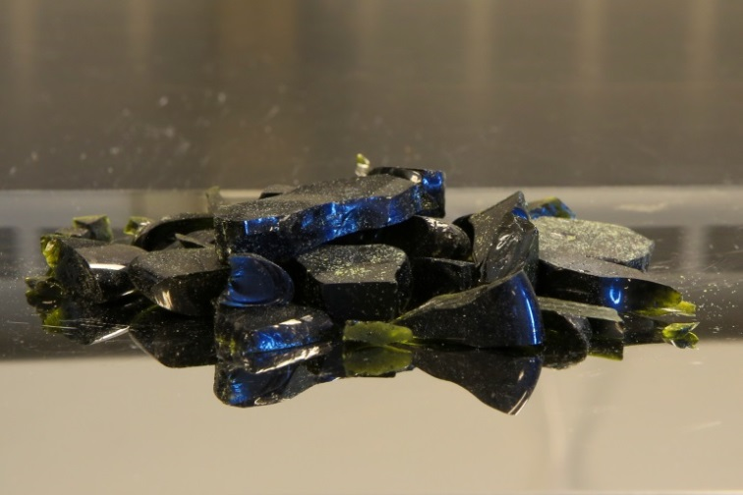
Glass development case study
(a)
(b)
High throughput glass chemistry screening
Graphite piping from molten glass test loop after testing at 1100 °C
Proprietary vanadium-based glass
Proprietary phosphate-based glass
(c)
(d)

Slide 17
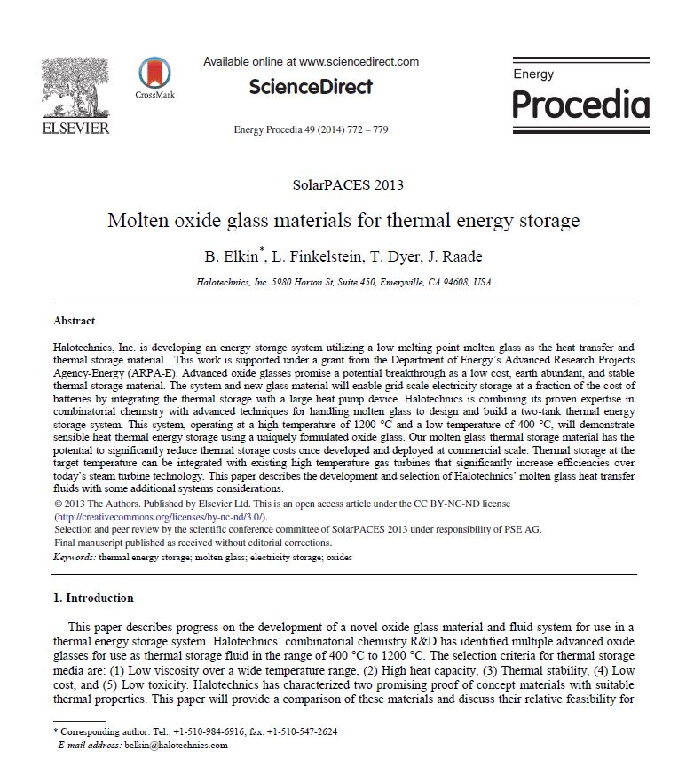
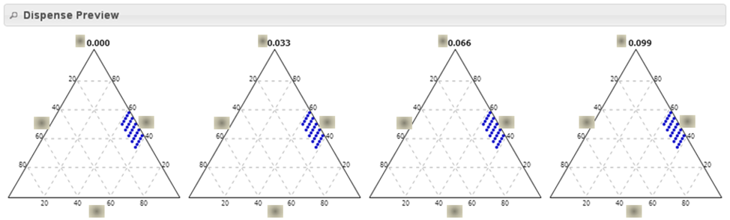
Glass development case study
Screened 397 unique glass compositions in search of thermal storage fluid
Experiments surveyed a broad phase space of silicate, phosphate, vanadate, and lead oxide glasses
100 distinct compositions are explored in a four-component phase space.
B. Elkin, et al., Energy Procedia: Proceedings of SolarPACES, Volume 49, 2014.

